Slide 1

DATA ANALYTICS
Unit 2:Ridge Regression
Mamatha.H.R
Department of Computer Science and
Engineering

Slide 2

DATA ANALYTICS
Unit 2:Ridge Regression
Mamatha H R
Department of Computer Science and Engineering

Slide 3

DATA ANALYTICS
Bias-Variance Trade-Off in Multiple Regression
The simple linear regression model, in which you aim at predicting n observations of the response variable, Y, with a linear combination of m predictor variables, X, and a normally distributed error term with variance σ²:
The true parameters, β, are not known we have to estimate them from the sample. In the Ordinary Least Squares (OLS) approach, we estimate them as β^ in such a way, that the sum of squares of residuals is as small as possible.

Slide 4

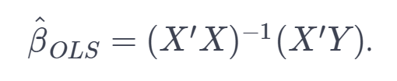
DATA ANALYTICS
Bias-Variance Trade-Off in Multiple Regression
In other words, we minimize the following loss function:
In order to obtain the infamous OLS parameter estimates,

Slide 5


DATA ANALYTICS
Bias-Variance Trade-Off in Multiple Regression
In statistics, there are two critical characteristics of estimators to be considered: the bias and the variance.
The bias is the difference between the true population parameter and the expected estimator:
It measures the accuracy of the estimates. Variance, on the other hand, measures the spread, or uncertainty, in these estimates. It is given by

Slide 6

DATA ANALYTICS
Bias-Variance Trade-Off in Multiple Regression
where the unknown error variance σ² can be estimated from the residuals as

Slide 7
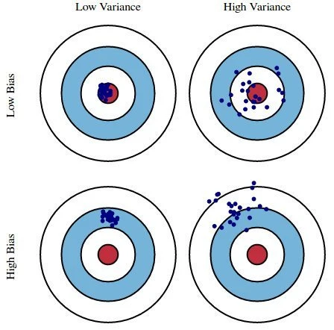
DATA ANALYTICS
Illustration of Bias and Variance
Imagine the bull's-eye is the true population parameter that we are estimating,
β, and the shots at it are the values of our estimates resulting from four different estimators - low bias and variance, high bias and variance, and the combinations.

Slide 8

DATA ANALYTICS
Bias-Variance Trade-Off in Multiple Regression
Both the bias and the variance are desired to be low, as large values result in poor predictions from the model.
In fact, the model's error can be decomposed into three parts:
error resulting from a large variance,
error resulting from significant bias,
and the remainder - the unexplainable part.

Slide 9
DATA ANALYTICS
Bias-Variance Trade-Off in Multiple Regression
The OLS estimator has the desired property of being unbiased. However, it can have a huge variance.
Specifically, this happens when:
The predictor variables are highly correlated with each other;
There are many predictors.
This is reflected in the formula for variance given above: if m approaches n, the variance approaches infinity.
The general solution to this is: reduce variance at the cost of introducing some bias.
This approach is called regularization and is almost always beneficial for the predictive performance of the model.

Slide 10
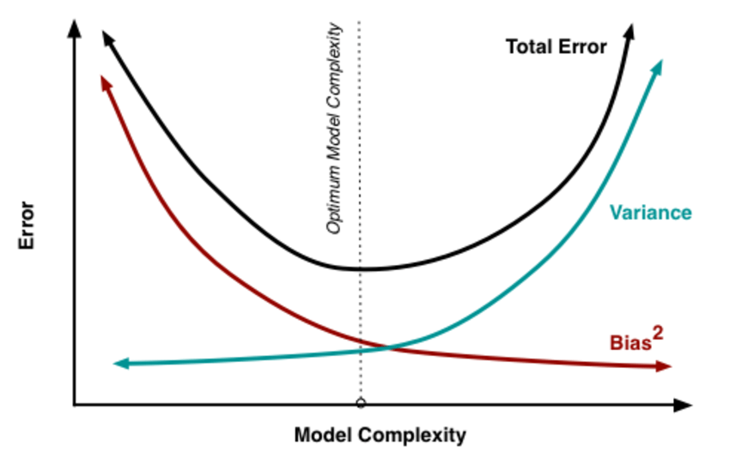
DATA ANALYTICS
Bias-Variance Trade-Off in Multiple Regression

Slide 11
DATA ANALYTICS
Bias-Variance Trade-Off in Multiple Regression
As the model complexity, which in the case of linear regression can be thought of as the number of predictors, increases, estimates' variance also increases, but the bias decreases.
The unbiased OLS would place us on the right-hand side of the picture, which is far from optimal.
That's why we regularize: to lower the variance at the cost of some bias, thus moving left on the plot, towards the optimum.

Slide 12
DATA ANALYTICS
What Ridge Regression does?
To decrease the model complexity, that is the number of predictors.
We could use the forward or backward selection for this, but that way we would not be able to tell anything about the removed variables' effect on the response.
Removing predictors from the model can be seen as settings their coefficients to zero.
Instead of forcing them to be exactly zero, let's penalize them if they are too far from zero, thus enforcing them to be small in a continuous way.
This way, we decrease model complexity while keeping all variables in the model.

Slide 13
DATA ANALYTICS
RIDGE REGRESSION
Ridge Regression is a technique used when the data suffers from multicollinearity (independent variables are highly correlated).
In this phenomenon, one predicted value in multiple regression models is linearly predicted with others to attain a certain level of accuracy.
The concept multicollinearity occurs when there are high correlations between more than two predicted variables.
In multicollinearity, even though the least squares estimates (OLS) are unbiased, their variances are large which deviates the observed value far from the true value.
By adding a degree of bias to the regression estimates, ridge regression reduces the standard errors.

Slide 14
DATA ANALYTICS
RIDGE REGRESSION
Important Points:
The assumptions of this regression is same as least squared regression except normality is not to be assumed
Ridge regression shrinks the value of coefficients but doesn’t reaches zero, which suggests no feature selection feature
This is a regularization method and uses l2 regularization.

Slide 15

DATA ANALYTICS
MODEL SPECIFICATION
In Ridge Regression, the OLS loss function is augmented in such a way that we not only minimize the sum of squared residuals but also penalize the size of parameter estimates, in order to shrink them towards zero.

Slide 16
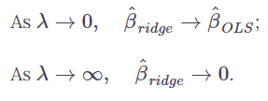
DATA ANALYTICS
MODEL SPECIFICATION (Contd..)
The λ parameter is the regularization penalty and β ridge is defined as below:
So, setting λ to 0 is the same as using the OLS, while the larger its value, the stronger is the coefficients' size penalized.

Slide 17
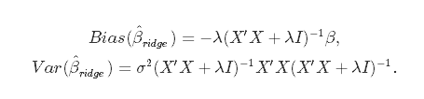
DATA ANALYTICS
Bias-Variance Trade-Off in Ridge Regression
Incorporating the regularization coefficient in the formulas for bias and variance.
From there you can see that as λ becomes larger, the variance decreases, and the bias increases.

Slide 18
DATA ANALYTICS
Choice of Regularization Parameter
Question : how much bias are we willing to accept in order to decrease the variance? Or: what is the optimal value for λ?
Due to the raise of these questions ,
A more traditional approach would be to choose λ such that some information criterion, e.g., AIC or BIC, is the smallest. approach emphasizes the model's fit to the data
A more machine learning-like approach is to perform cross-validation and select the value of λ that minimizes the cross-validated sum of squared residuals . is more focused on its predictive performance

Slide 19

DATA ANALYTICS
Minimizing Information Criteria
This approach boils down to estimating the model with many different values for λ and choosing the one that minimizes the Akaike or Bayesian Information Criterion:
where df_{ridge} is the number of degrees of freedom.
The number of degrees of freedom in ridge regression is different than in the regular OLS!

Slide 20

DATA ANALYTICS
Choice of Regularization Parameter
In both OLS and ridge regression, degrees of freedom are equal to the trace of the so-called hat matrix, which is a matrix that maps the vector of response values to the vector of fitted values as follows:
In OLS, we find that H_{OLS} = X(X′X)−1X, which gives df_{OLS} = trH_{OLS} = m, where m is the number of predictor variables. In ridge regression, however, the formula for the hat matrix should include the regularization penalty: H_{ridge} = X(X′X + λI)−1X, which gives df_{ridge} = trH_{ridge}, which is no longer equal to m.

Slide 21
DATA ANALYTICS
Minimizing cross-validated residuals
To choose λ through cross-validation, you should choose a set of P values of λ to test, split the dataset into K folds
for p in 1:P:
for k in 1:K:
keep fold k as hold-out data
use the remaining folds and λ = λp to estimate β^ridge
predict hold-out data: ytest,k=Xtest,kβ^ridge
compute a sum of squared residuals: SSRk = ||y − ytest, k||2
end for k
average SSR over the folds: SSRp=1K∑Kk=1SSRk
end for p
choose optimal value: λopt = argminpSSRp

Slide 22
DATA ANALYTICS
References
https://www.datacamp.com/community/tutorials/tutorial-ridge-lasso-elastic-net
https://www.analyticsvidhya.com/blog/2015/08/comprehensive-guide-

Slide 23
THANK YOU
Dr.Mamatha H R
Professor,Department of Computer Science
mamathahr@pes.edu
+91 80 2672 1983 Extn 834

